Slide 1
Risk Management Solutions
ROBUST RISK MANAGEMENT FOR
ISLAMIC BANKING
&
FINANCIAL INSTITUTIONS
Tashkent, March’23
© Copyright Avati Consulting Solutions 2023
This document is confidential and is intended solely for the use and information of the client/partner to whom it is addressed.

Slide 2
RISK PROFILE – THE NEED FOR ROBUSTNESS
Common
Credit Risk
Market Risk
Operational Risk
Liquidity Risk
Islamic Banks & Financial Institutions
Unique
Rate of return Risk
Displaced Commercial Risk
Equity Investment Risk
Inventory Risk
Shariah noncompliance Risk

Slide 3
ASSET LIABILITY CHALLENGES / OPPORTUNITY
Profit rate risk
Duration analysis
Net interest income impact analysis
Economic value of equity reporting under multiple stress scenarios
For liquidity risk there are following reports –
Liquidity coverage ratio
Net stable funding ratio
Structural liquidity report which is similar to maturity letter report
Net FX open position report
Core or stable deposits modelling using current accounts and savings accounts data
Dynamic liquidity report taking into account future profits and growth

Slide 4
AVATI CONSULTING SOLUTIONS
Avati provides a specialized, niche, state of the art integrated risk management platform for active risk management, financial control and compliance for banks and financial institutions.

Slide 5
OUR UNIQUE PROPOSITION
DOMAIN KNOWLEDGE
Unique Synergy
Relationship Based Advisory & Support
TECHNOLOGY EXPERTISE
EFFICIENT IMPLEMENTATION
Flexible & Extensible
Efficient Project Processes
PRODUCT DESIGN
Proprietary Risk Frameworks
Empowered Knowledge transfer

Slide 6
OUR KEY CLIENTS - RISK MANAGEMENT PROJECTS
We possess vast experience in delivering Enterprise Risk Management through our Integrated risk platform, RiskCube. We have enabled banks to successfully implement Risk transformation programs including management of data architecture. Our key clients are listed below. We differentiate ourselves by delivering end to end solution including model development, validation, refinements, data management, IFRS 9 ECL system, configurable rules, Early warning dashboards (EWS), comprehensive reporting with complete automation
Al Rajhi Bank
Islamic Arab International Bank
Qatar International Islamic Bank
Jordan Kuwait Bank Group
Mashreq Bank
Arab Petroleum Investment Corporate
KSA & Jordan
IFRS 9 Model Development & Landscape
IFRS 9 System Implementation
Automation – Integrat3ed Data Management, ECL scoring, CBJ Reporting
KSA - Consulting & functional advisory for Oracle Basel II System – Development of Basel II Risk & Finance Logical Data Mart
Jordan
Validation & Development of IFRS 9 framework
Comprehensive IFRS 9 System & CBJ Reporting including
Complete Automation – Integrated Data Management, IFRS 9 Business Rules, ECL calculation, Regulatory Reporting
Qatar
Comprehensive IFRS 9 Model Development & Validation
IFRS 9 System Implementation – Core Data Integration & Consolidation, Staging & Business Rules, One Touch Imply & Reporting
Comparative & What if Analysis.
Jordan
IFRS 9 Implementation & CBJ Reporting
Integration with Moody's tools for LGD and ECL calculation
Automation – Integrated Data Management, ECL scoring, CBJ Reporting
New Mandate : System for ALM, CAP, ICAAP, Stress Testing and EWS.
United Arab Emirates
Review of IFRS 9 ECL computation and accounting CVA / DVA for derivative exposures
Validation of Credit Value Adjustment for Derivative exposures
Validation of Standardized Approach Country party Credit Risk Framework for Derivatives
Saudi Arabia & Bahrain
Validation of Risk Rating Model & Specialized lending Scorecards
Devt. of Market Risk & FTP Framework including implementation of Market Risk System
Implementation of Credit Risk Rating System for all Rating Models and Scorecards

Slide 7
OUR KEY CLIENTS - RISK MANAGEMENT PROJECTS
Jordan Commercial Bank
Equitas Small Finance Bank
National Bank of Umm Al Qaiwain
Banque Saudi Fransi
Jordan
Devt. of Market Risk & FTP Framework including implementation of Market Risk System
Implementation of Credit Risk Rating System for all Rating Models and Scorecards
Validation of Risk Rating Model & Specialized lending Scorecards
New Mandate : System for ALM, CAP, FTP, RAROC, ICAAP & Stress Testing
India
Development & Modification of IFRS 9 Modeling framework
Comprehensive IFRS 9 ECL & EIR System Implementation & Reporting including Disclosures
Integrated Data Management, Configuration of Business Rules, ECL calculation, Reporting, MIS, Dashboard
UAE
IFRS 9 Corporate, Retail & Cards exhaustive Model review.
Model recommendation and development.
Stress Testing review as per CBUAE guideline for 2022-23.
Recommendation and fact findings to the management to enable drawing up of the future roadmap.
Saudi Arabia
Functional Consulting & Advisory Support for Algorithmic Basel II & Credit Workflow System Implementation
Risk Appetite Framework devt
Facility Risk Rating & Collateral Management
Rollout of RCSA framework & Workshops
Edelweiss Finance
InvestBank Group
The Arab Investment Company
India
IFRS 9 Wholesale Lending ECL Model Development
Retail Lending Credit Risk, ECL model modification and calibration
IFRS 9 ECL computation support
Jordan
IFRS 9 Model Development & Landscape
Group wide IFRS 9 System Implementation – Integration & Consolidation of data, systems, rules for 6 different entities
Complete Automation – Integrated Data Management, IFRS 9 Business Rules, ECL calculation, CBJ Reporting
KSA & Bahrain
Implementation of Asset Liability & Liquidity Management System
Implementation of Basel II Implementation system including reporting based on SAMA guidelines
Implementation of Credit Risk Rating & Scoring System for Credit Risk Management including Credit Workflow

Slide 8
DOMAIN – PRODUCTS - KNOWLEDGE
‘RiskCube’, an Integrated specialized platform enabling Strategic Functions, Decision
Support, Risk Management & Compliance for Banks & Financial Institutions
IFRS9 ECL, Capital Calculation, Profit gap risk & Liquidity management, ALM & Balance Sheet Management, Capital Allocation & Reporting System including Stress Testing.
Early Warning System (EWS), Credit Modeling & hosting platform, Integrated Banking Data Model compliant to BCBS 239
Risk Consulting covering Portfolio & Management Reporting, Basel III+ & IV
Capital, IFRS 9, Market & Liquidity Risk, Credit Risk Modelling, Risk Data Warehouse
implementation in leading Banks in Middle East & Levant region
Strong domain knowledge, product design, technology platform and implementation
capability, its core team having worked with leading banks and financial institutions across 6 countries

Slide 9
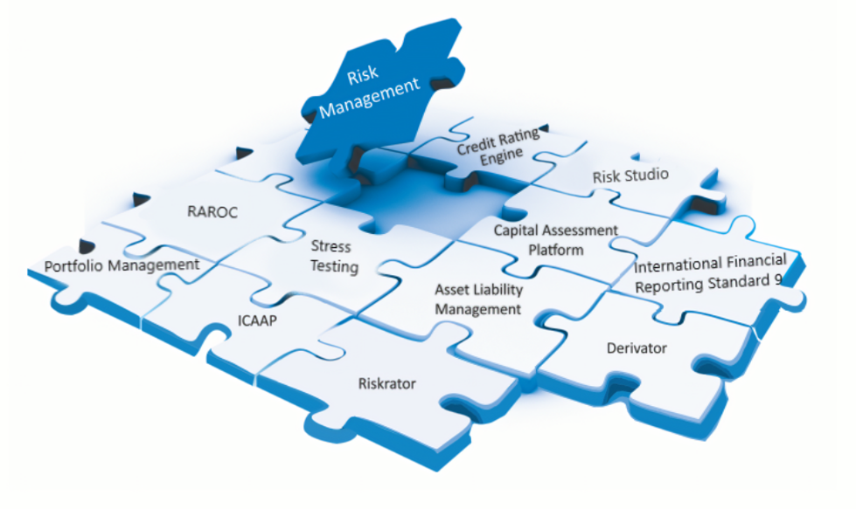
PRODUCT SUITE FOR RISK MANAGEMENT

Slide 10
ERM TECHNOLOGY LANDSCAPE & COMPONENTS
Transaction /
Core Systems
Risk Data Mart
Enterprise wide Risk & Capital Management Modules
Dashboard
Risk Appetite
Statement
Retail Risk
Analytics
Risk Appetite
Statement
Market Risk
Engine & Hedging
Credit Rating
& Scoring Models
Operational Risk
Business Planning &
Budgeting
Monitoring & Validation
Stress Testing
Engine
Capital Planning &
Pillar II Computation
IFRS 9 – Framework
& Exp. Credit Loss
ALM: Liquidity &
Balance Sheet Management
Regulatory Capital
Calculation & Reporting
Risk Based Pricing &
RAROC Estimation
T1
EXCEL
T2
T3
T4
EXCEL
Comprehensive Risk Data Mart / Aggregation –BCBS 23General Ledger & Accounting Reconciliation
Portfolio Analysis & Mgt. Dash Boards

Slide 11
THANK YOU!
AVATI CONSULTING SOLUTIONS FZC LLC
A-63-01-05-03 Flamingo Villas
Ajman Media City Free Zone, P. O. Box 4422
United Arab Emirates
AVATI CONSULTING SOLUTIONS (P) LTD.
Corporate Office, H/335, Kanakia Zillion, LBS Marg, CST Road Junction, Kurla West, Mumbai 400070, India

